Slide 1
CSE 220
Jannatun Noor
Jannatun.noor@bracu.ac.bd
Lecture Made by: Aminul Huq

Slide 2
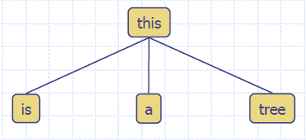
What is a Tree
In computer science, a tree is an abstract model of a hierarchical structure
A tree consists of nodes with a parent-child relationship
Applications:
Organization charts
File systems
Programming environments

Slide 3
What is a Tree
A connected acyclic graph is a tree
A tree T is a set of nodes in a parent-child relationship with the following properties:
T has a special node r, called the root of T, with no parent node
Each node v of T, different from r, has a unique parent node u
A tree cannot be empty, since it must have at least one node – the root.

Slide 4
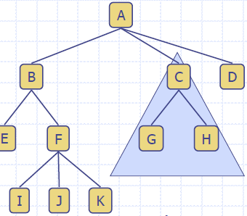
Tree Terminology
Root: node without parent (A)
Internal node: node with at least one child (A, B, C, F)
External node (Leaf ): node without children (E, I, J, K, G, H, D)
Ancestors of a node: parent, grandparent, grand-grandparent, etc.
Descendants of a node: child, grandchild, grand-grandchild, etc.
Depth of a node: number of ancestors, excluding the node itself
Height of a tree: maximum depth of any node (3)
Siblings: two nodes that are children of the same parent
Subtree: tree consisting of a node and its descendants

Slide 5
Depth and Height
The depth of a node v can be recursively defined as follows
If v is the root, then the depth of v is 0.
Otherwise, the depth of v is one plus the depth of the parent of v
Algorithm depth(T, v)
if T.isRoot(v) then
return 0
else
return 1 + depth(T, T.parent(v))

Slide 6
Depth and Height
The height of a node v can be recursively defined as follows
If v is a leaf node, then the height of v is 0.
Otherwise, the height of v is one plus the maximum height of a child of v
The height of a tree T is the height of the root of T
The height of a tree T is equal to the maximum depth of a leaf node of T
The height of a node is the longest path (i.e. number of edges) from the node to a leaf node.
Algorithm height1(T)
h = 0
for each v εT.positions(v) do
if T.isExternal(v) then
h = max(h, depth(T, v))
return h

Slide 7
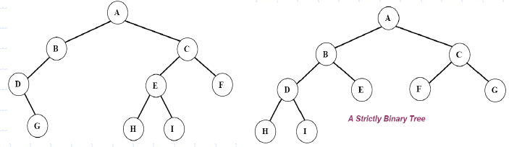
Ordered Trees
A tree is ordered if there is a linear ordering defined for each child of each node.
A binary tree is an ordered tree in which every node has at most two children.
If each node of a tree has either zero or two children, the tree is called a proper (strictly) binary tree.

Slide 8
Traversal of Trees
A traversal of a tree T is a systematic way of visiting all the nodes of T
Traversing a tree involves visiting the root and traversing its subtrees
There are the following traversal methods:
Preorder Traversal
Postorder Traversal
Inorder Traversal (of a binary tree)

Slide 9
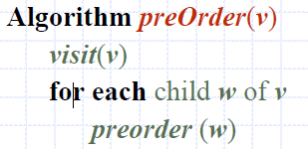
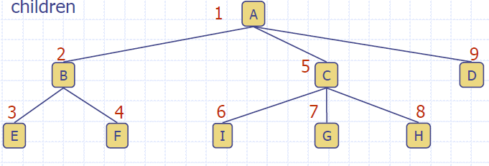

Preorder Traversal
In a preorder traversal, a node is visited before its descendants
If a tree is ordered, then the subtrees are traversed according to the order of the children

Slide 10
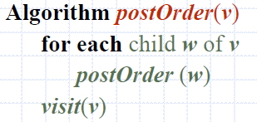
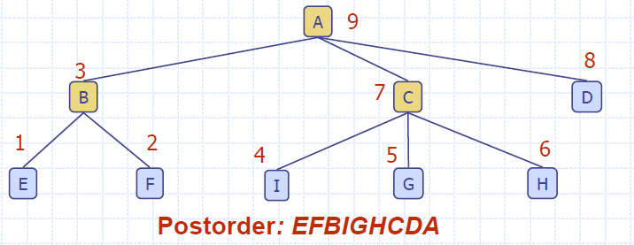
Postorder Traversal
In a postorder traversal, a node is visited after its descendants

Slide 11
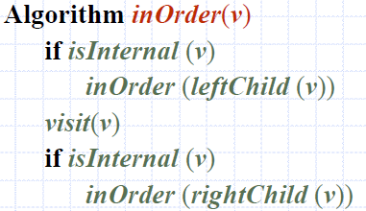
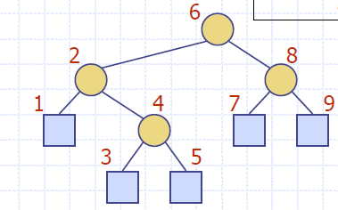

Inorder Traversal
In an inorder traversal a node is visited after its left subtree and before its right subtree

Slide 12
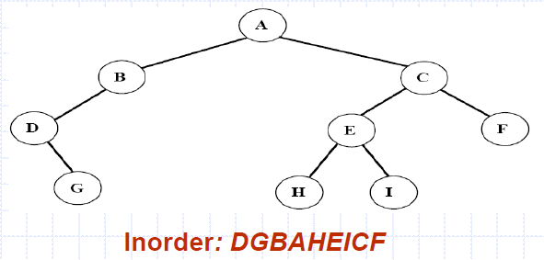
Inorder Traversal
Traversing a binary tree in inorder
Traverse the left subtree in inorder.
Visit the root.
Traverse the right subtree in inorder.

Slide 13
Binary Tree
A (proper/full) binary tree is a tree with the following properties:
Each internal node has two children
The children of a node are an ordered pair
We call the children of an internal node left child and right child Alternative recursive definition: a (proper) binary tree is either
a tree consisting of a single node, or
a tree whose root has an ordered pair of children, each of which is a binary tree
Applications:
arithmetic expressions
decision processes
searching

Slide 14
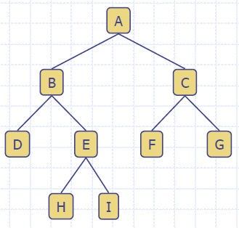

Slide 15
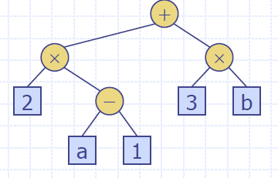
Arithmetic Expression Tree
Binary tree associated with an arithmetic expression
internal nodes: operators
external nodes: operands Example: arithmetic expression tree for the expression (2 * (a - 1) + (3 * b))

Slide 16
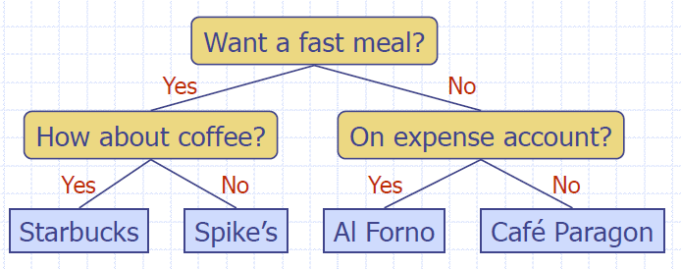
Decision Tree
Binary tree associated with a decision process
internal nodes: questions with yes/no answer
external nodes: decisions Example: dining decision

Slide 17
Full binary tree and complete binary tree
A binary tree T is full if each node is either a leaf or possesses exactly two child nodes.
A binary tree T with n levels is complete if all levels except possibly the last are completely full, and the last level has all its nodes to the left side.

Slide 18
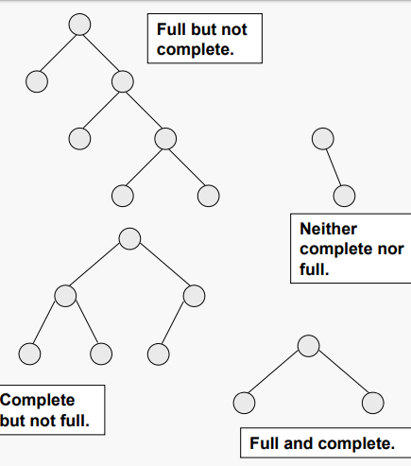
Example

Slide 19

Binary Tree Representations
A binary tree data structure is represented using two methods. Those methods are as follows...
Array Representation
In array representation of a binary tree, we use one-dimensional array (1-D Array) to represent a binary tree.
Linked List Representation
linked list representation, a node has the following structure...

Slide 20
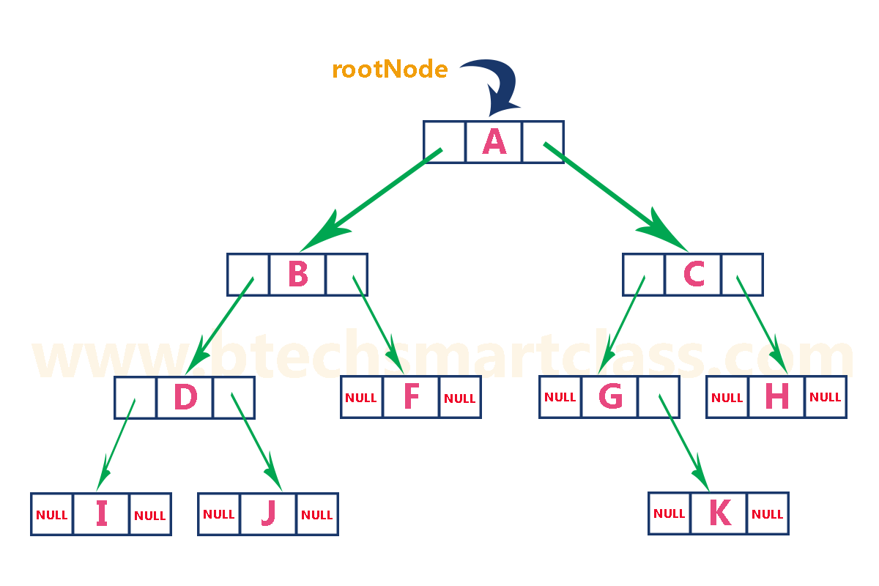
Binary Tree Representations (linked list)

Slide 21
How to calculate maximum number of internal, external, and total nodes using height and level of a binary tree?

